Slide 1
CSE-5335: Presentation
Team Members:
COOPMAN, Matthew (1000872057)
KARNA, PRANAY (1002172761)
Kodipunjula, LOKESHWAR (1002175121)
NERELLA, PAVAN (1002152799)
PASUPULETI, SAI (1002182871)

Slide 2
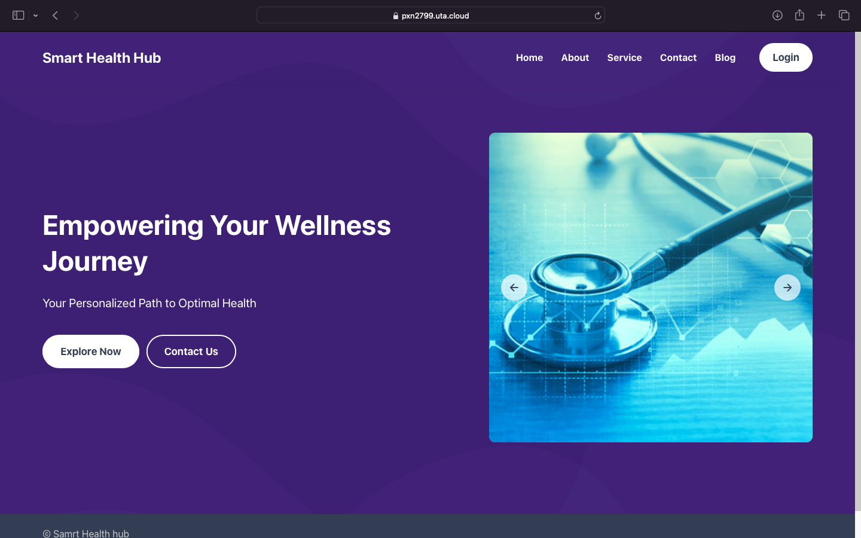
The homepage serves as a virtual brochure, providing a comprehensive overview of the web application.
The Navigation bar at the top of the page is there for all pre-login pages that can be used to navigate other pages which can be accessed before login.
Additionally, the homepage features convenient "Register Now" and "Login" buttons, offering seamless navigation to access these respective pages

Slide 3
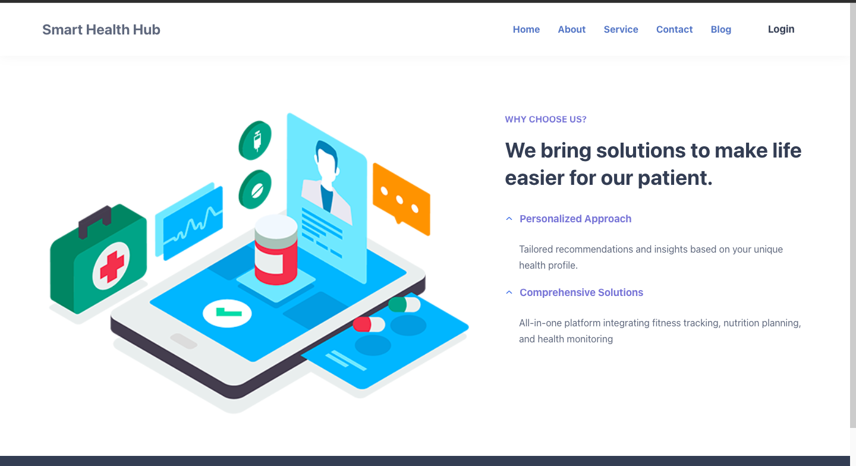
The About Us page functions as an informative hub, offering details and insights about the website's purpose and mission
When hovering over program objectives, they are dynamically highlighted for enhanced visibility and user interaction

Slide 4
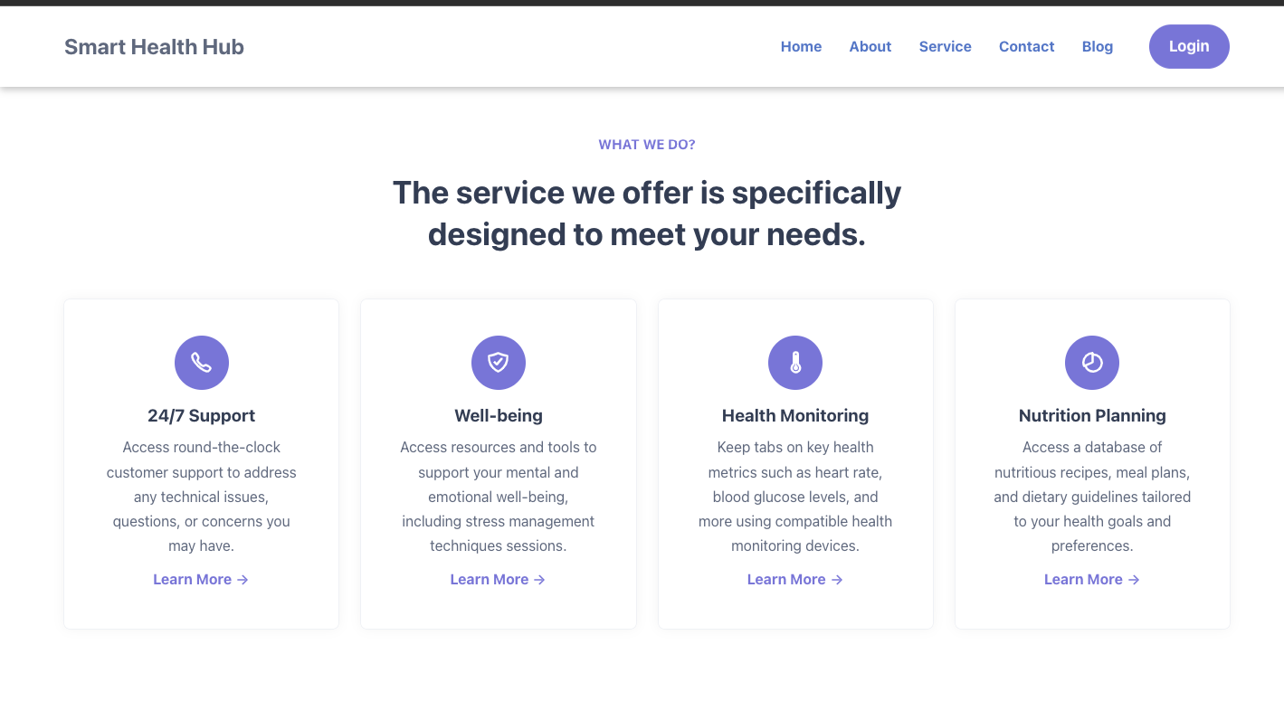
The Services page is designed to showcase and present a comprehensive array of offerings, providing detailed information about the diverse range of services available.

Slide 5
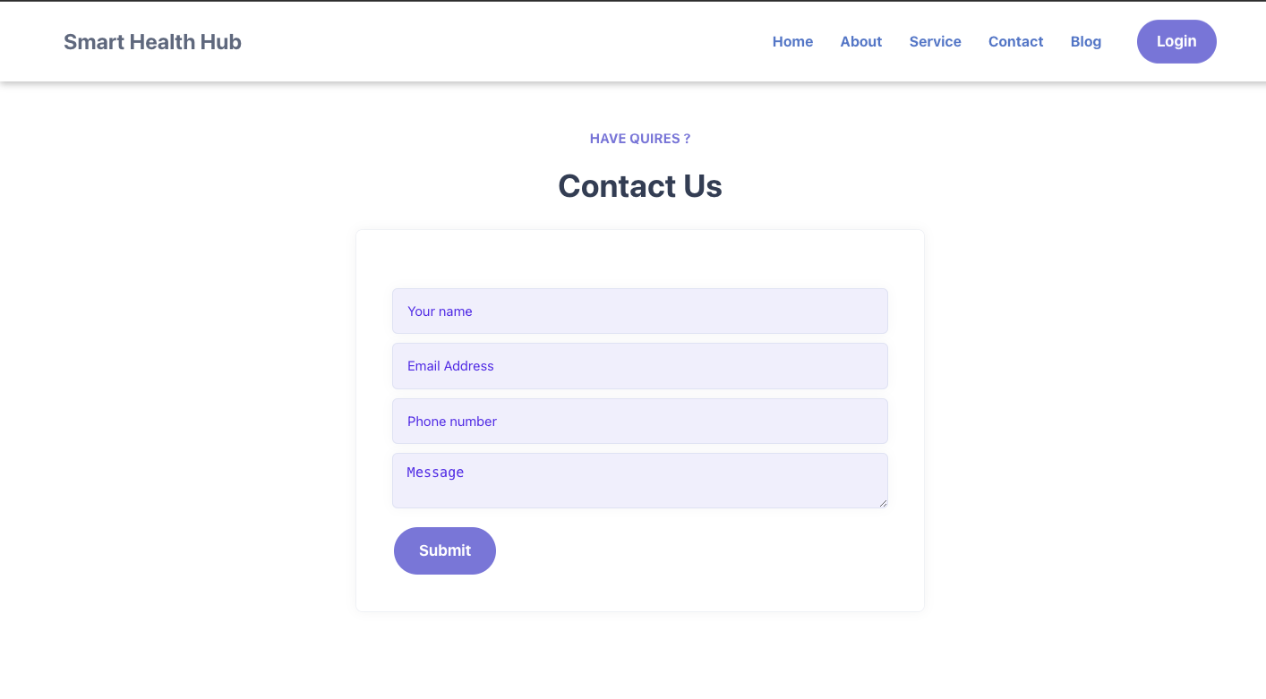
The Contact Us page serves as a dedicated channel for users to reach out and seek assistance. If any help or support is needed, this page provides a convenient means of communication.
Provide your name, email, phone number, and message.

Slide 6
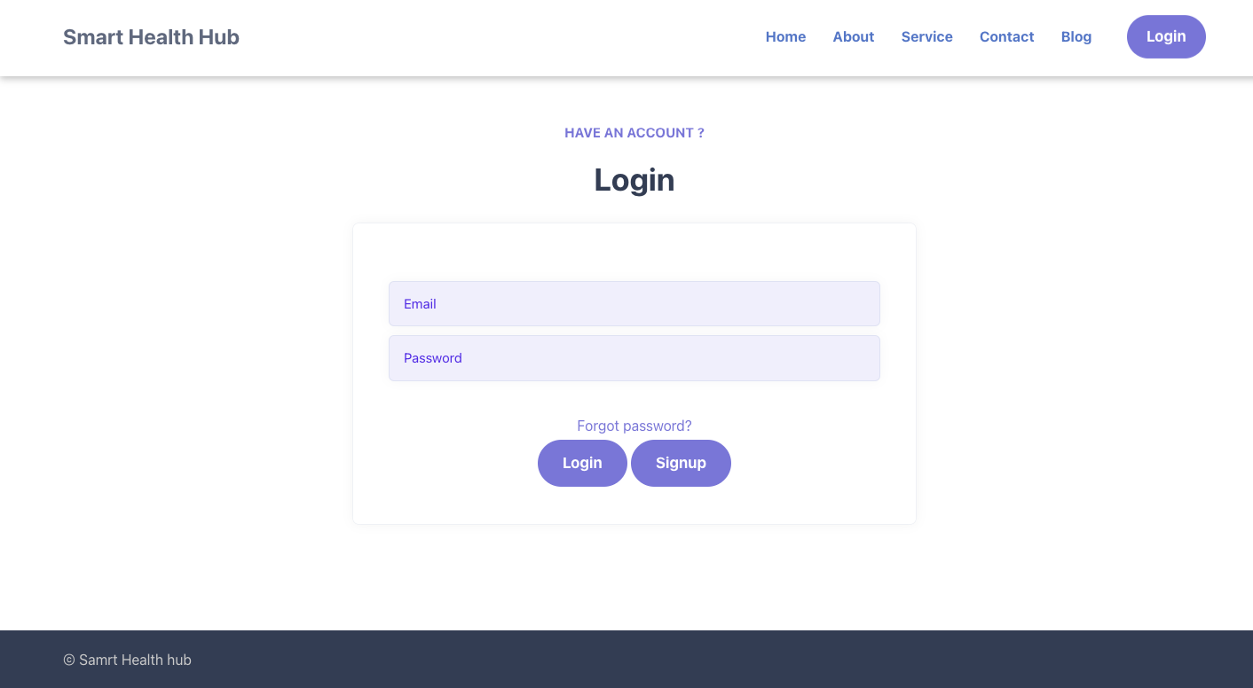
The Login page necessitates registered users to input their E-Mail and Password for authentication and access to the system.
These two inputs are required for user differentiation. Utilizing these details will guide individuals to their designated dashboards based on their specified roles.
In the event that users forget their passwords, a convenient 'Forgot Password' feature is available to facilitate password resets

Slide 7
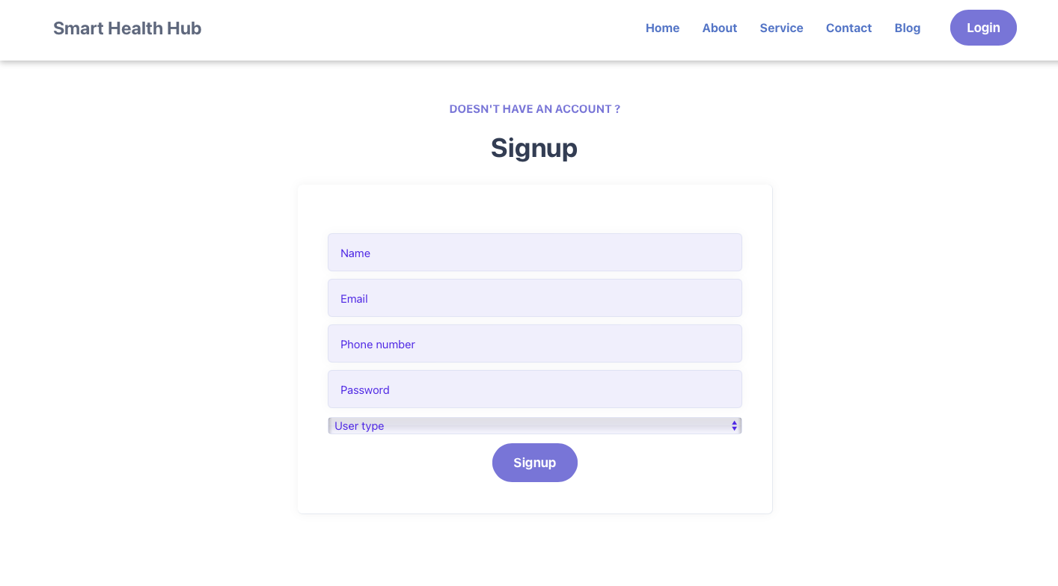
The signup page is used to register a new user
To complete the registration process, users are required to provide the following details: Name, E-Mail, Password, Phone Number, and User Type (specify the role they are seeking signup for).

Slide 9
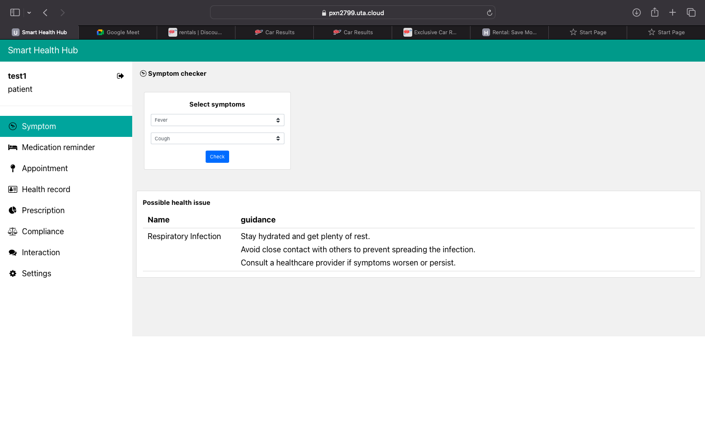
Patients can check their symptoms by selecting the options that been provided to determine potential health issues or diseases.
They can get the necessary guidance and information about their diseases

Slide 10
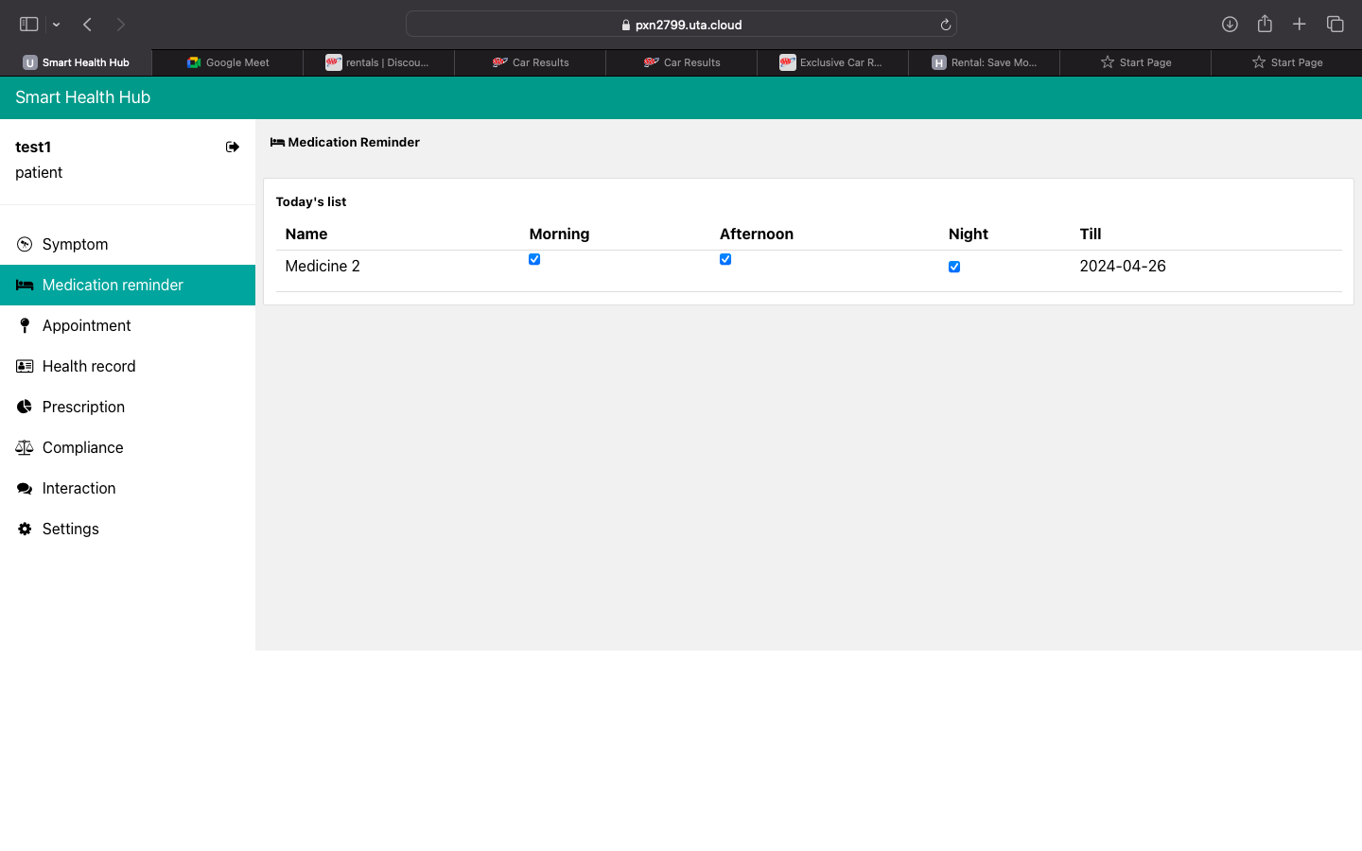
In the medication reminder, patients will be informed about their medication that was prescribed by the doctor
And they will be informed till which date should he need to take the medication.

Slide 11
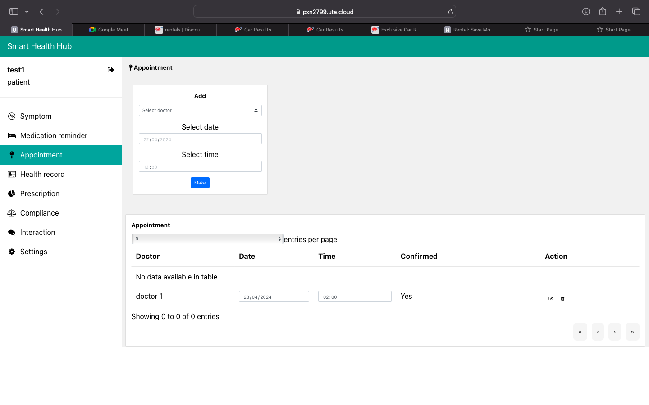
In the appointment page the patient can book an appointment with the doctors that are available
This user needs to select the doctor, the date, and the time for the appointment
After booking the appointment the user needs to wait for the confirmation from the doctor

Slide 12
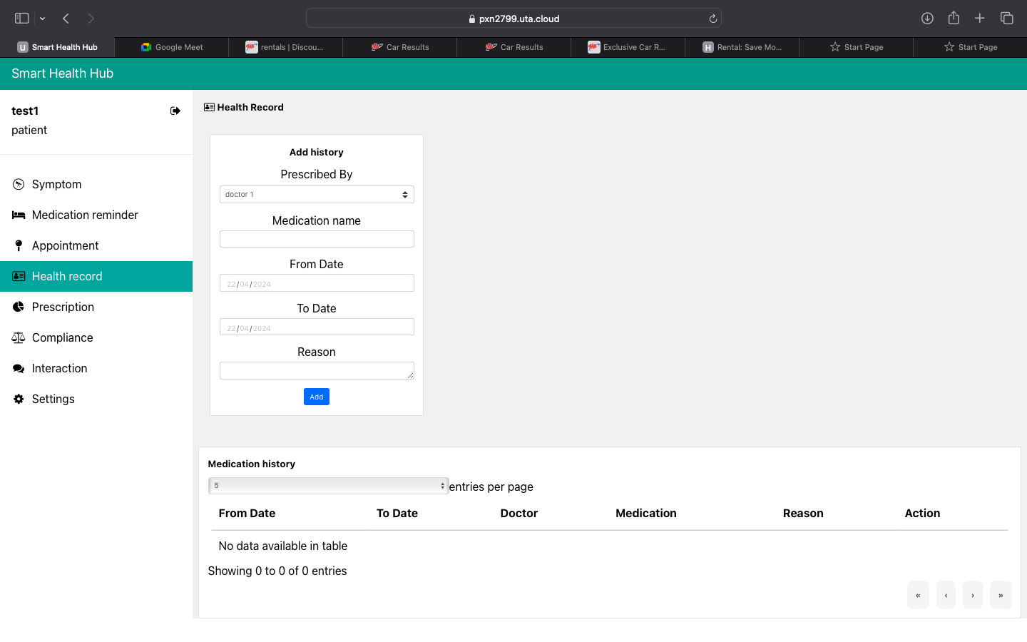
Patients need to update their health records which include:
Which doctor that they have taken appointment with.
The medication name provided by the doctor
Which date they got admitted
Which date they got discharged
The reasons of their admission

Slide 13
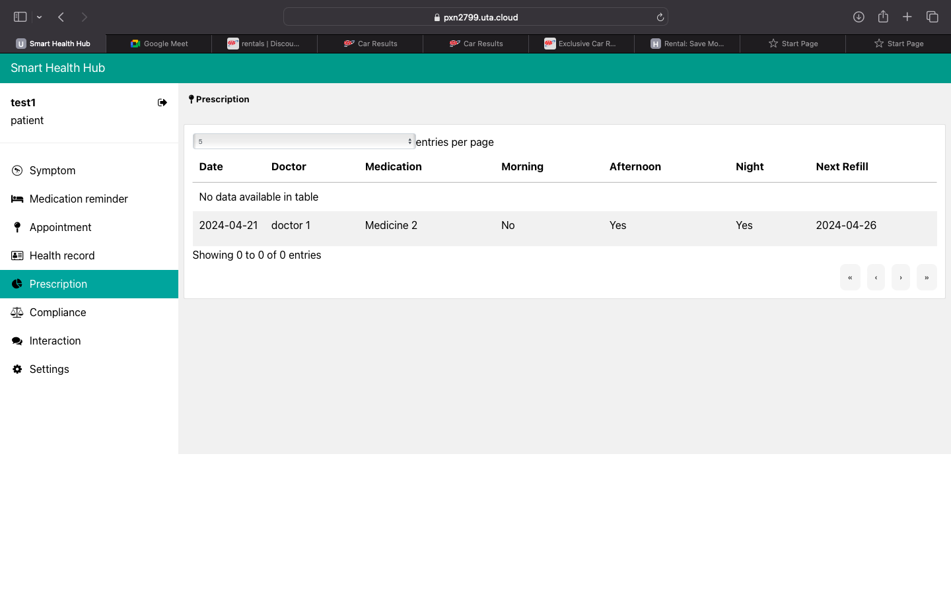
After the appointment with the doctor, the described prescription will be manually updated by the doctor
The details will be seen here

Slide 14
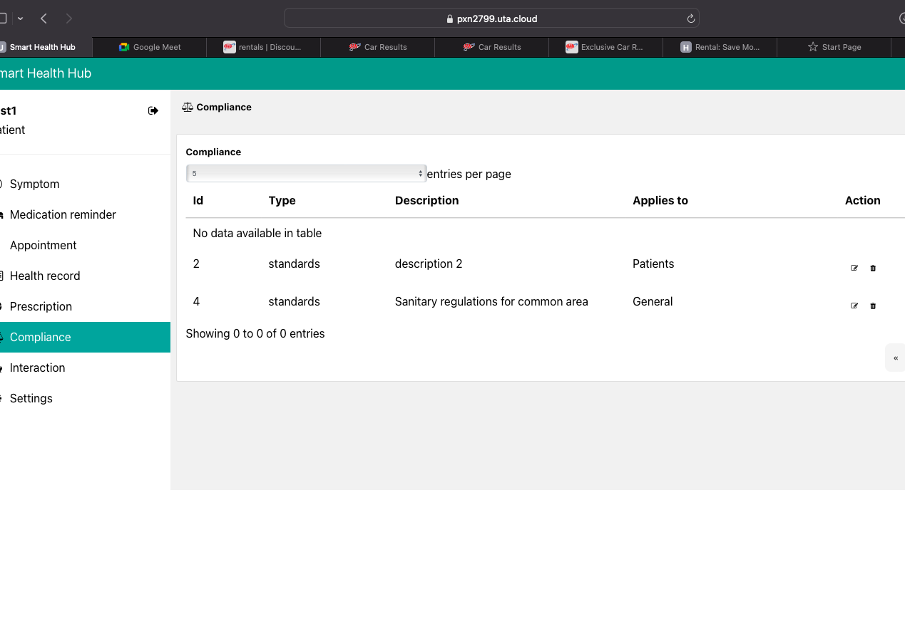
The compliance page shows a set of instructions and standards that needs to be followed by the patient, doctor, and/or pharmacist roles.

Slide 15
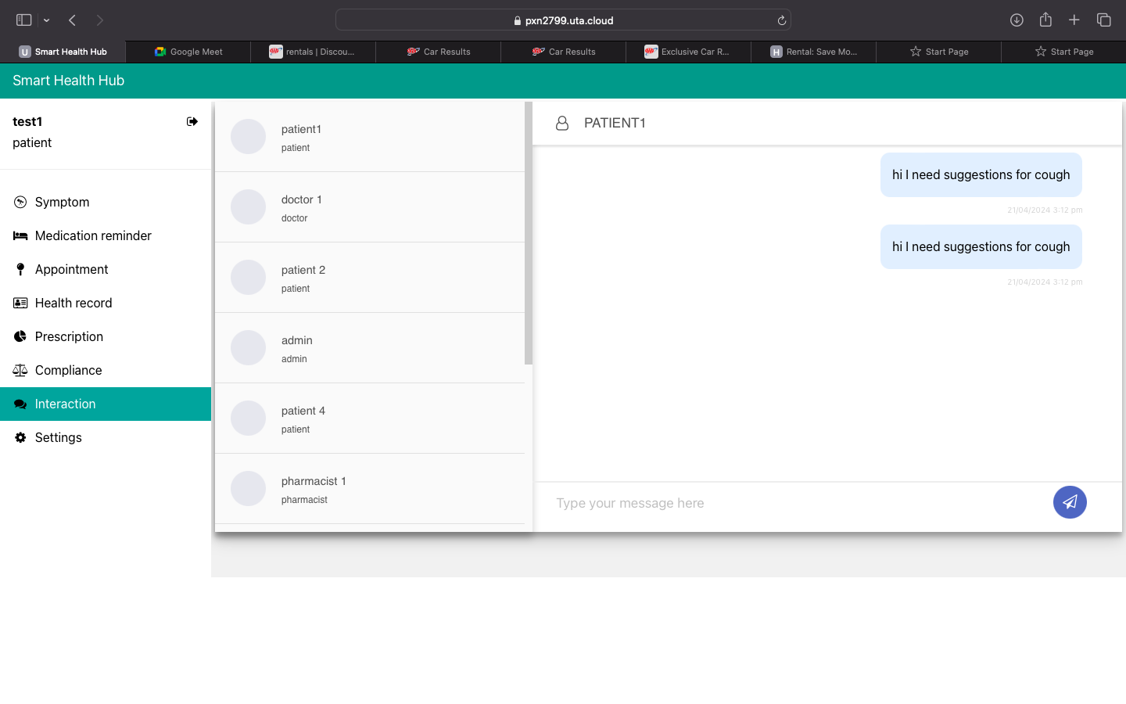
The user can chat with other users (sending/receiving messages).
Messages are exchanged privately (not visible to unrelated users).

Slide 16
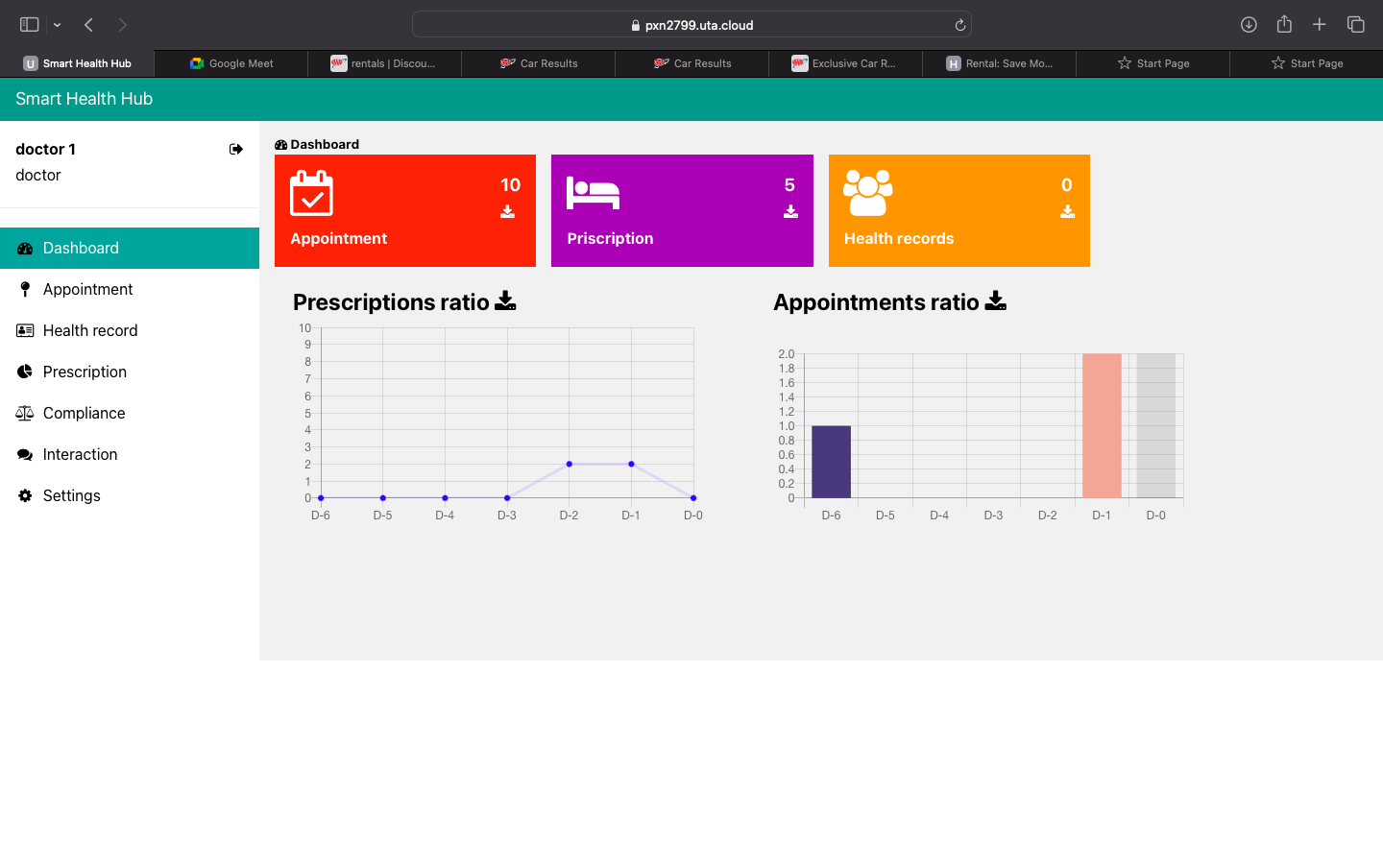
Here, the health provider or doctor can access the metrics regarding:
Prescriptions
Appointments
Health records

Slide 17
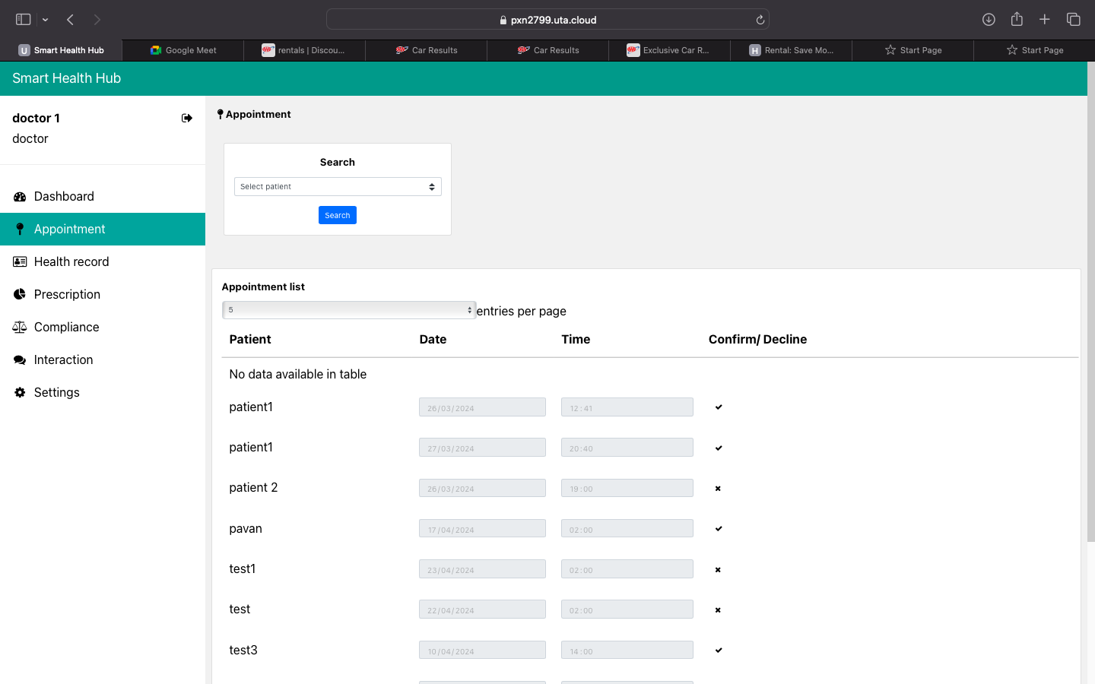
The doctor can view the appointments of the patients.
This user role can accept or decline a patient's appointment
This user role can also choose a particular patient and search for the patient.

Slide 18
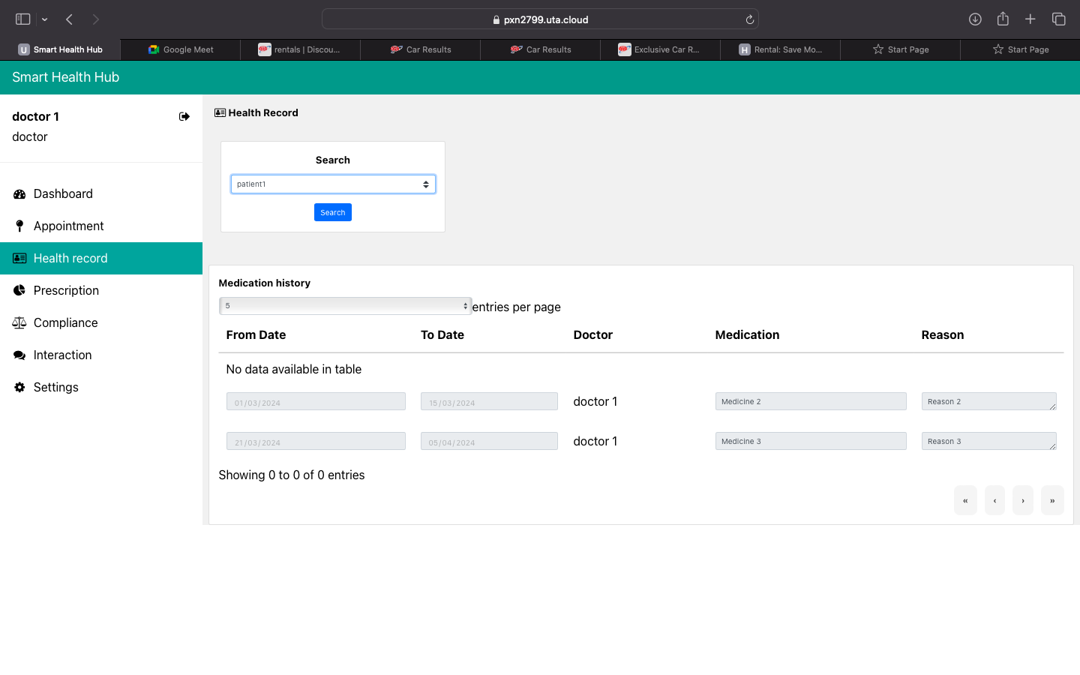
In the health records, the doctor can search for a patient's health records.
The health record contains the medication history that been updated by the patient manually.

Slide 19
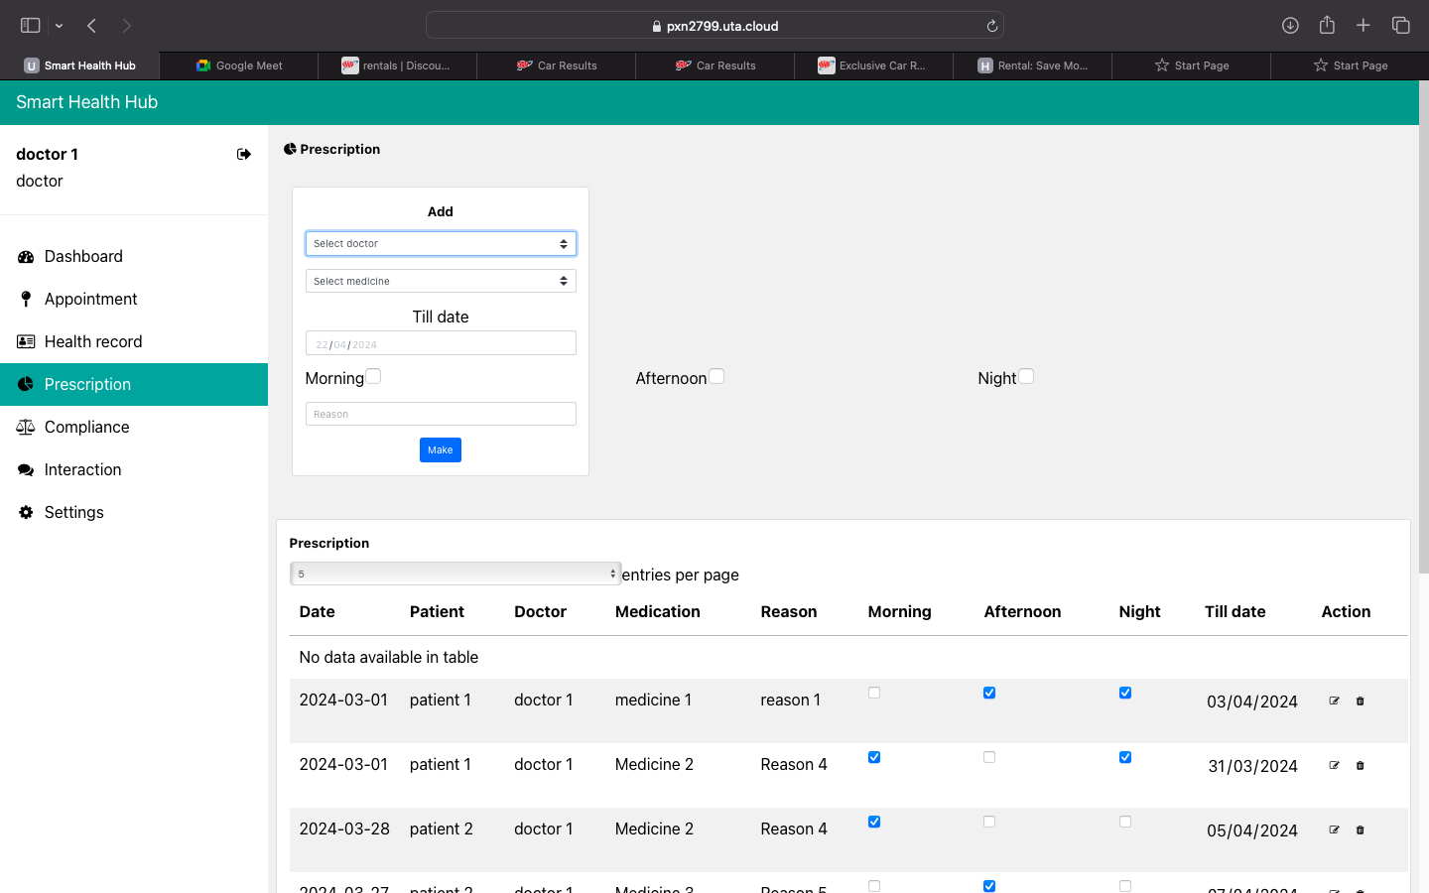
Doctors can add a prescription for the patient (select patient through the drop down)
They can suggest the medication that need to be taken at which time and the till date

Slide 20
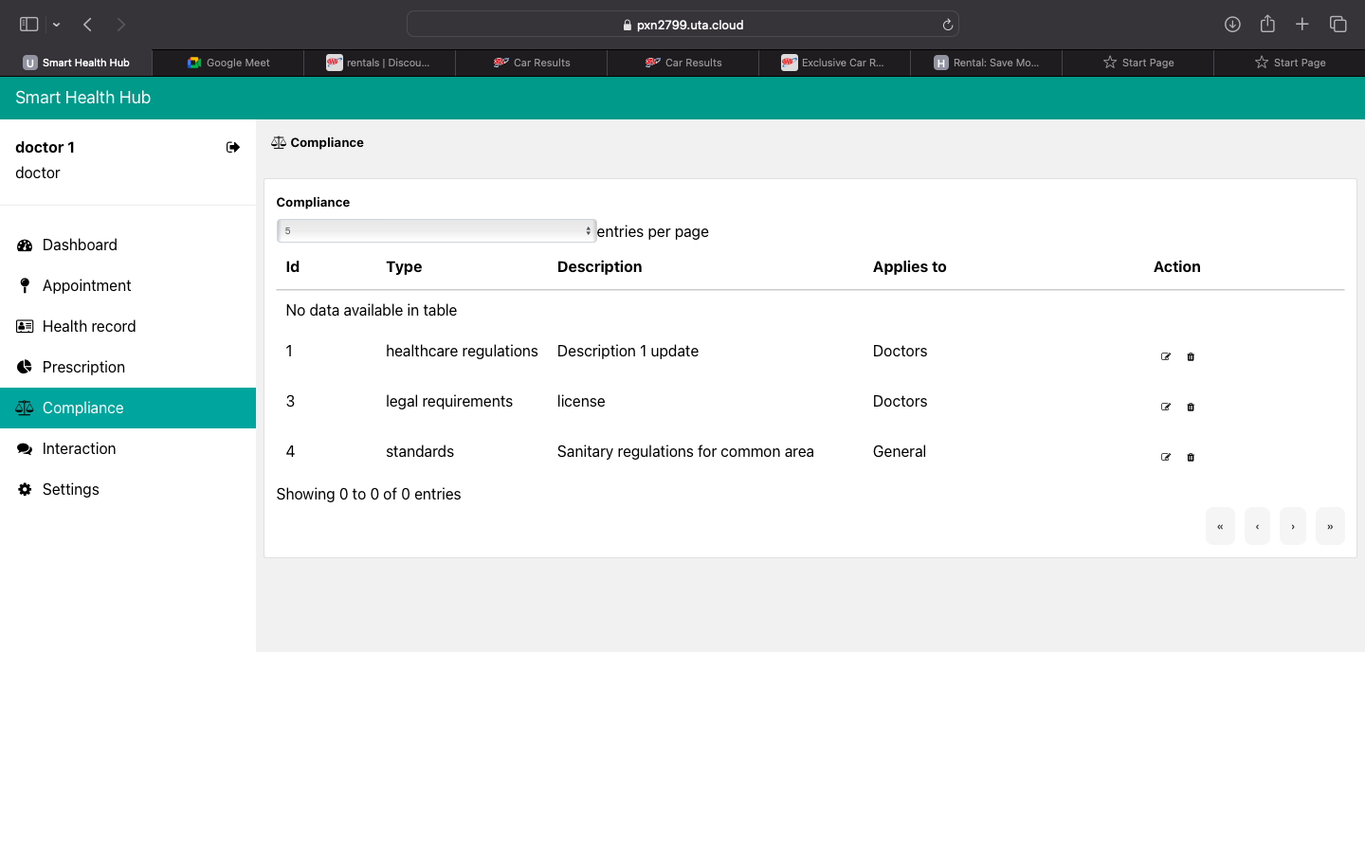
The compliance page shows a set of instructions and standards that needs to be followed by the patient, doctor, and/or pharmacist roles.

Slide 21
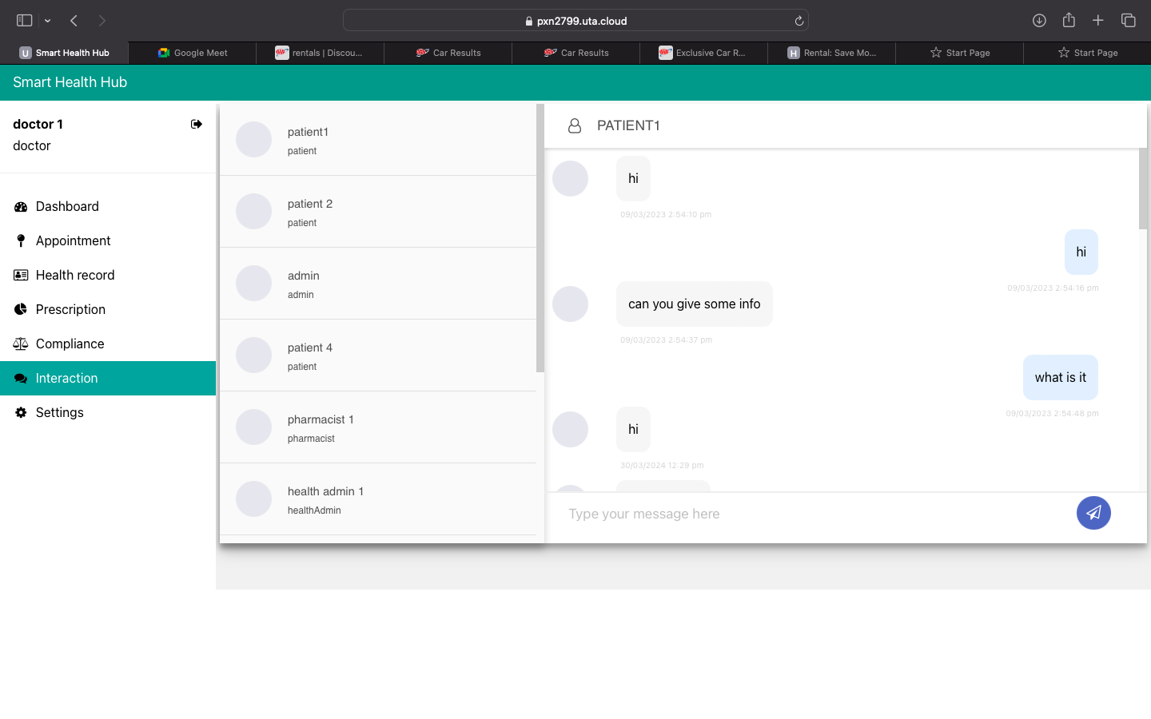
The user can chat with other users (sending/receiving messages).
Messages are exchanged privately (not visible to unrelated users).

Slide 22
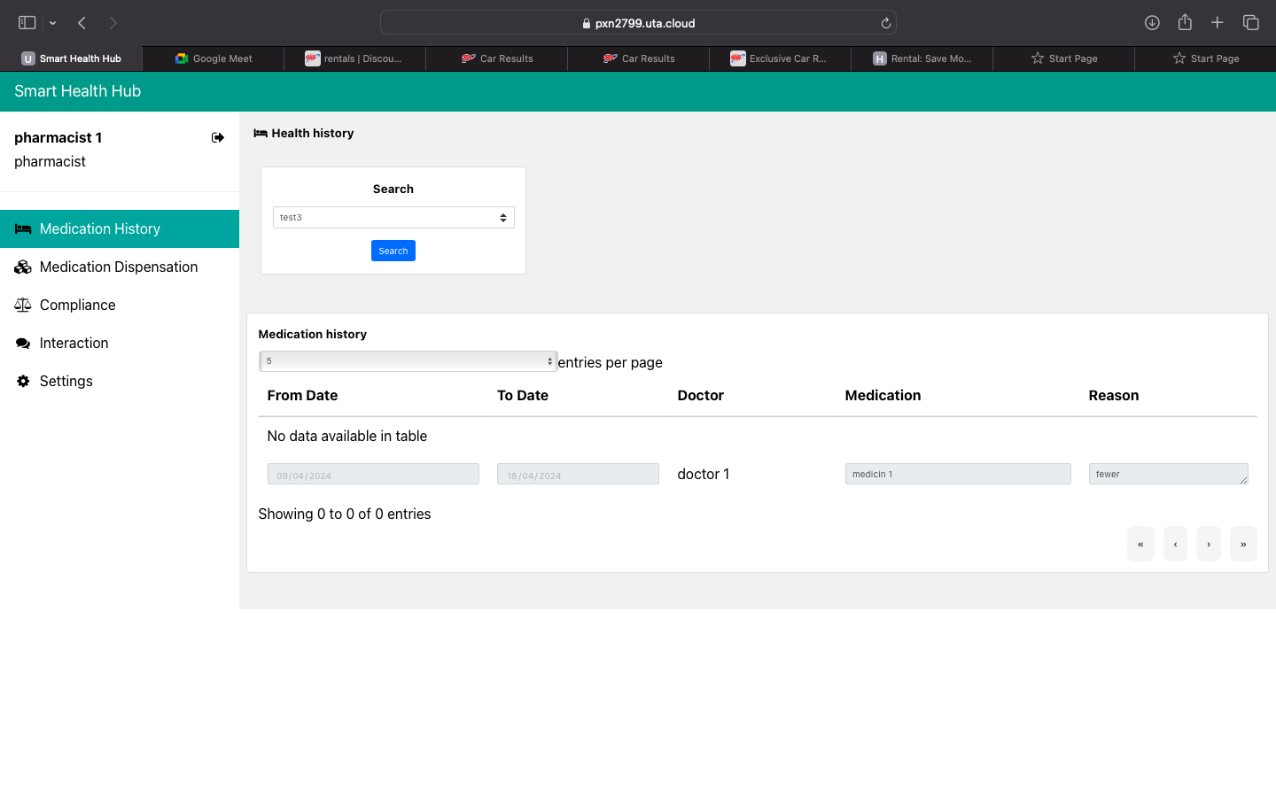
The medication that was provided to the patient will be seen here. The reasons and the doctor who suggested the medication will be displayed here too.

Slide 23
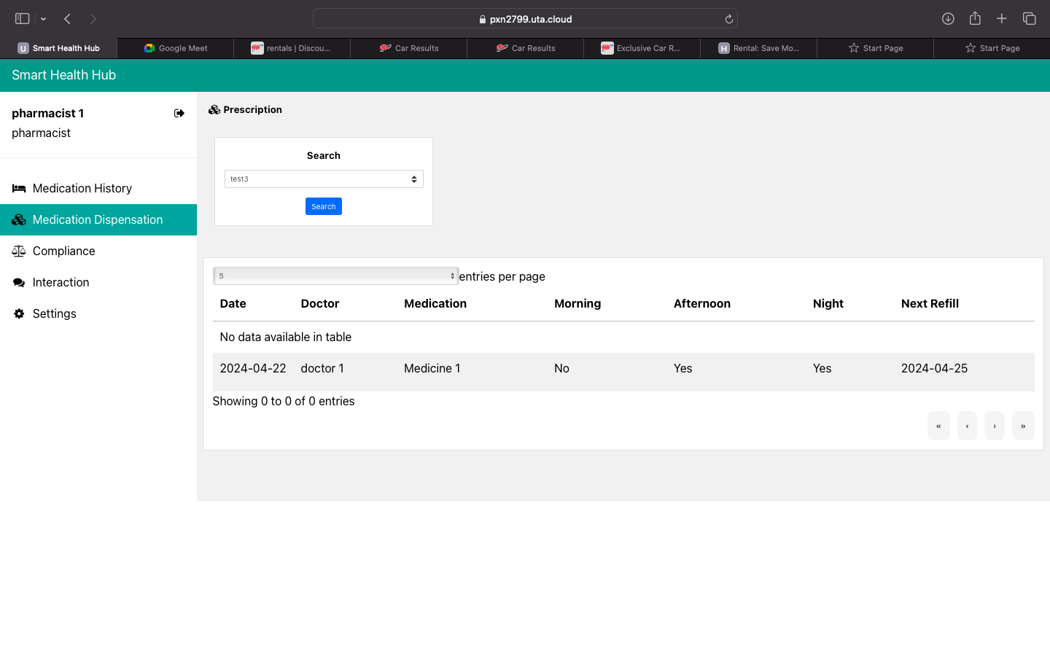
In the medication dispensation, the pharmacist can get the records of the patient about the medication that was prescribed by the doctor

Slide 24
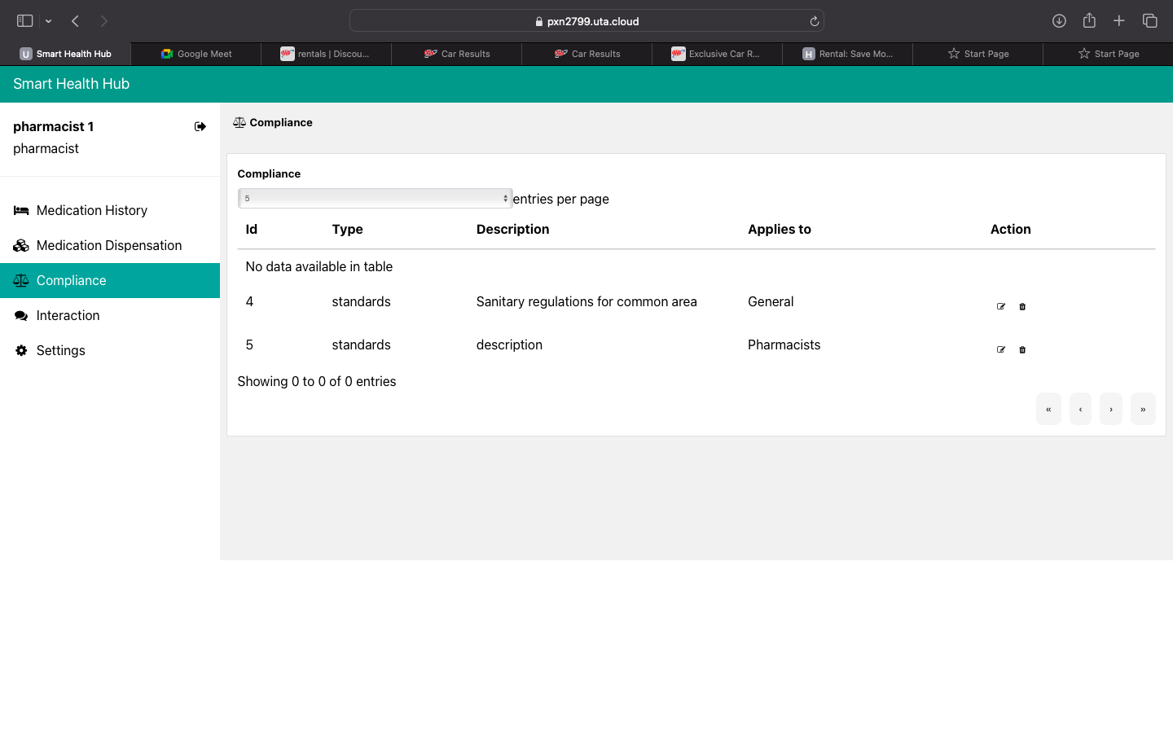
The compliance page shows a set of instructions and standards that needs to be followed by the patient, doctor, and/or pharmacist roles.

Slide 25
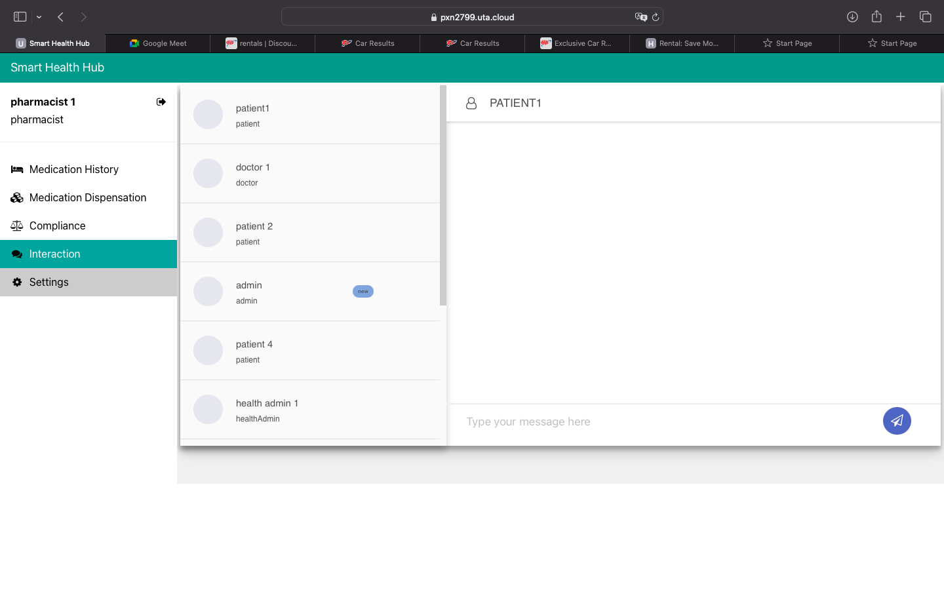
The user can chat with other users (sending/receiving messages).
Messages are exchanged privately (not visible to unrelated users).

Slide 26
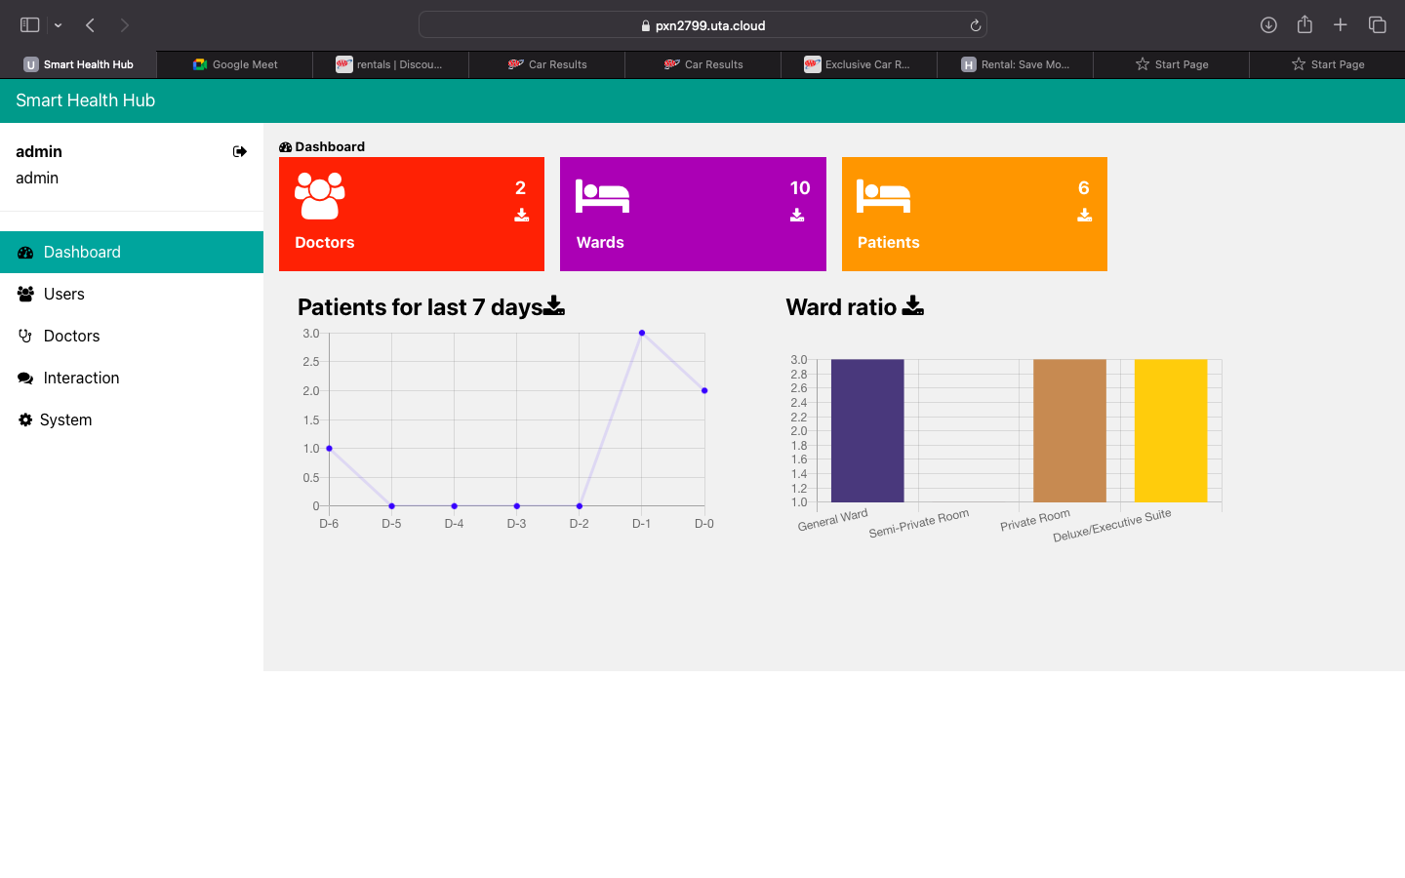
Here, the admin can access the data of the doctors, wards, patients in a .csv file

Slide 27
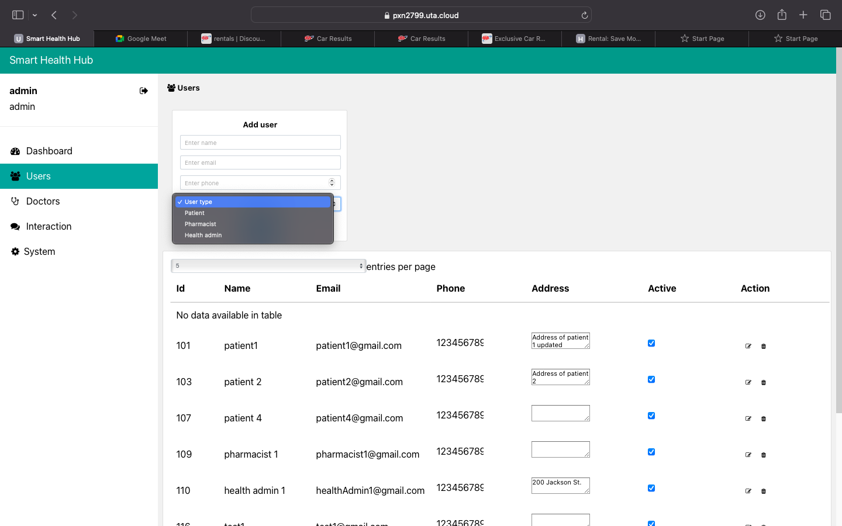
The admin can manage the profiles of different user types (patient, pharmacist, and health admin) here.
This user type can add a user's profile of a specific user type by selecting the drop down. The admin can also delete a user's profile.

Slide 28
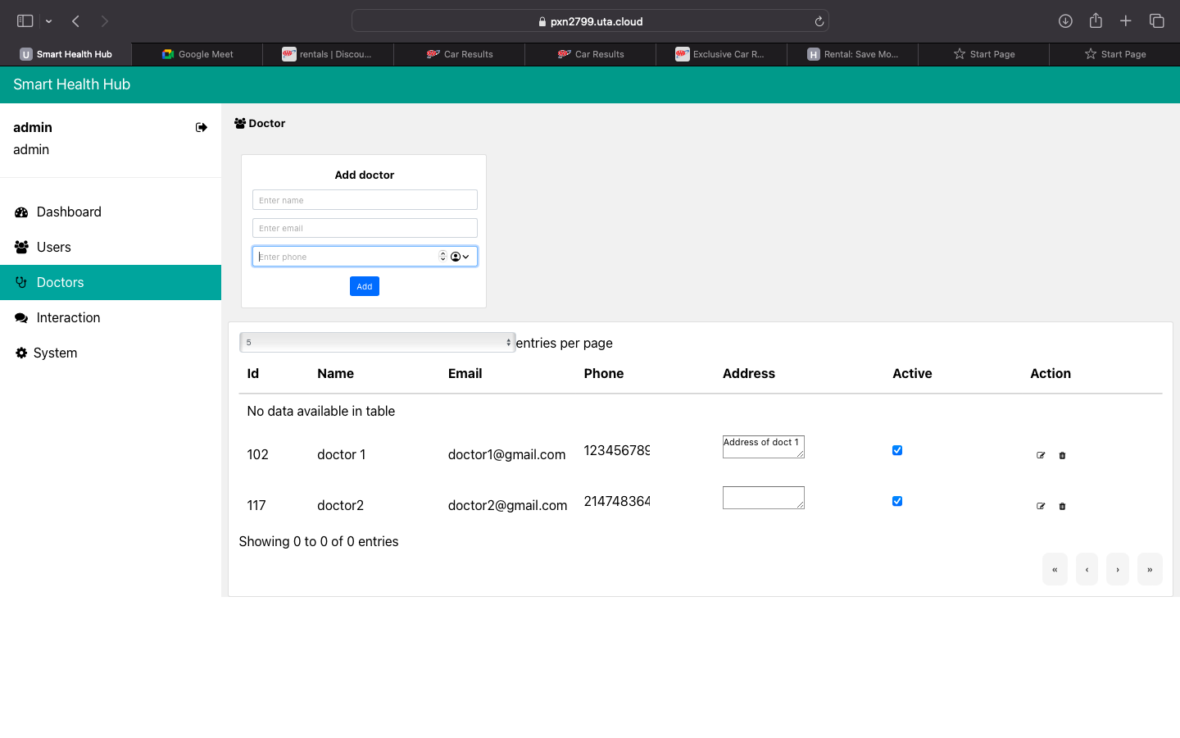
The admin can manage the profiles of the doctors there. He can add or delete the user's profile.

Slide 29
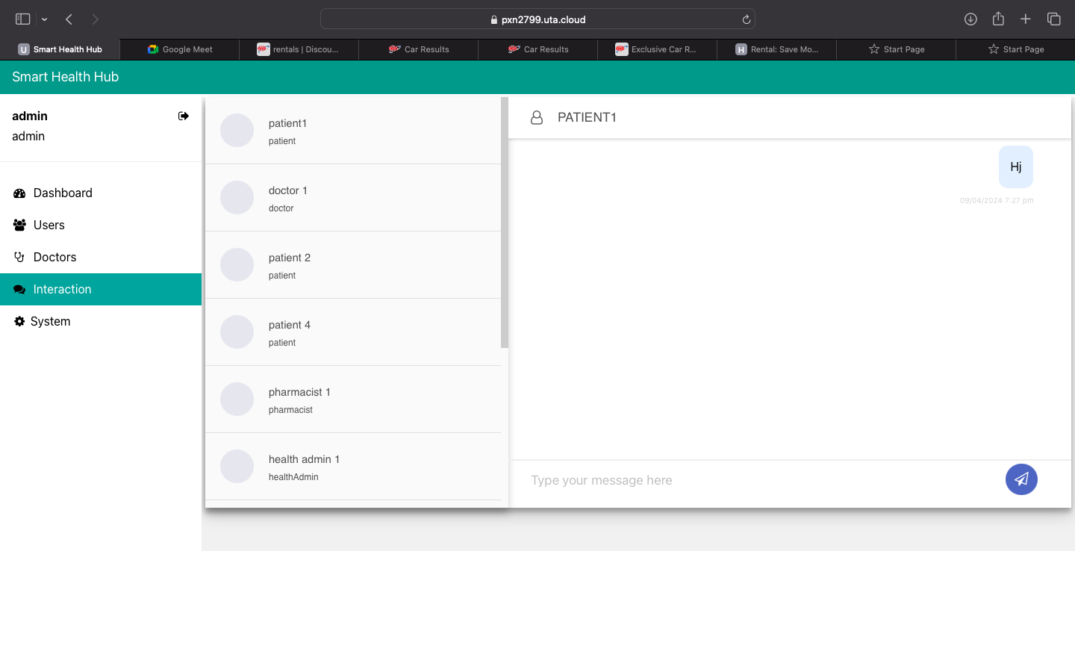
The user can chat with other users (sending/receiving messages).
Messages are exchanged privately (not visible to unrelated users).

Slide 30
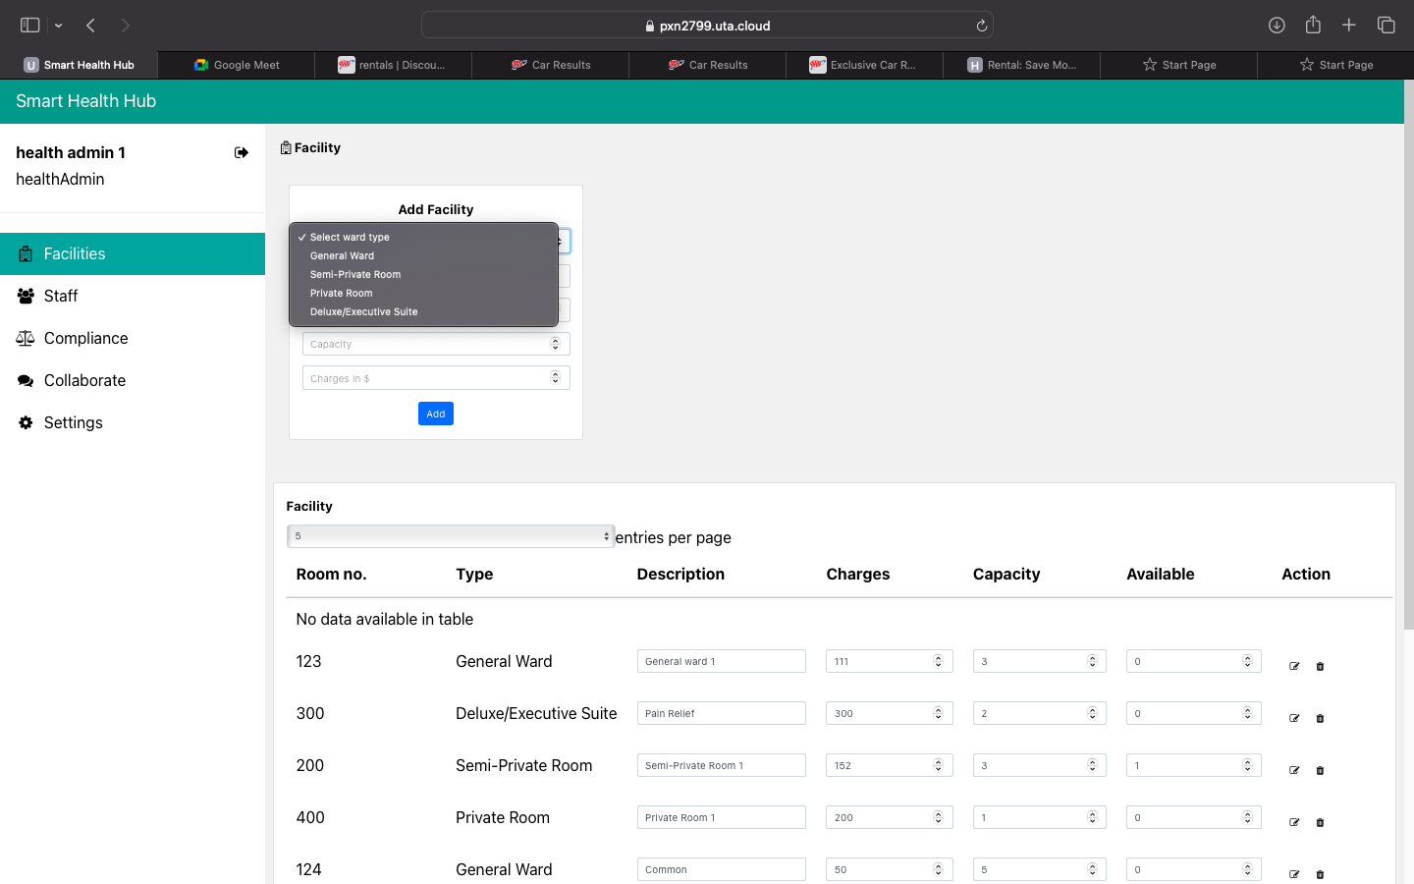
The health admin can manage facilities for the hospital
This user can add/modify/delete rooms
The price and availability of the room can be set here

Slide 31
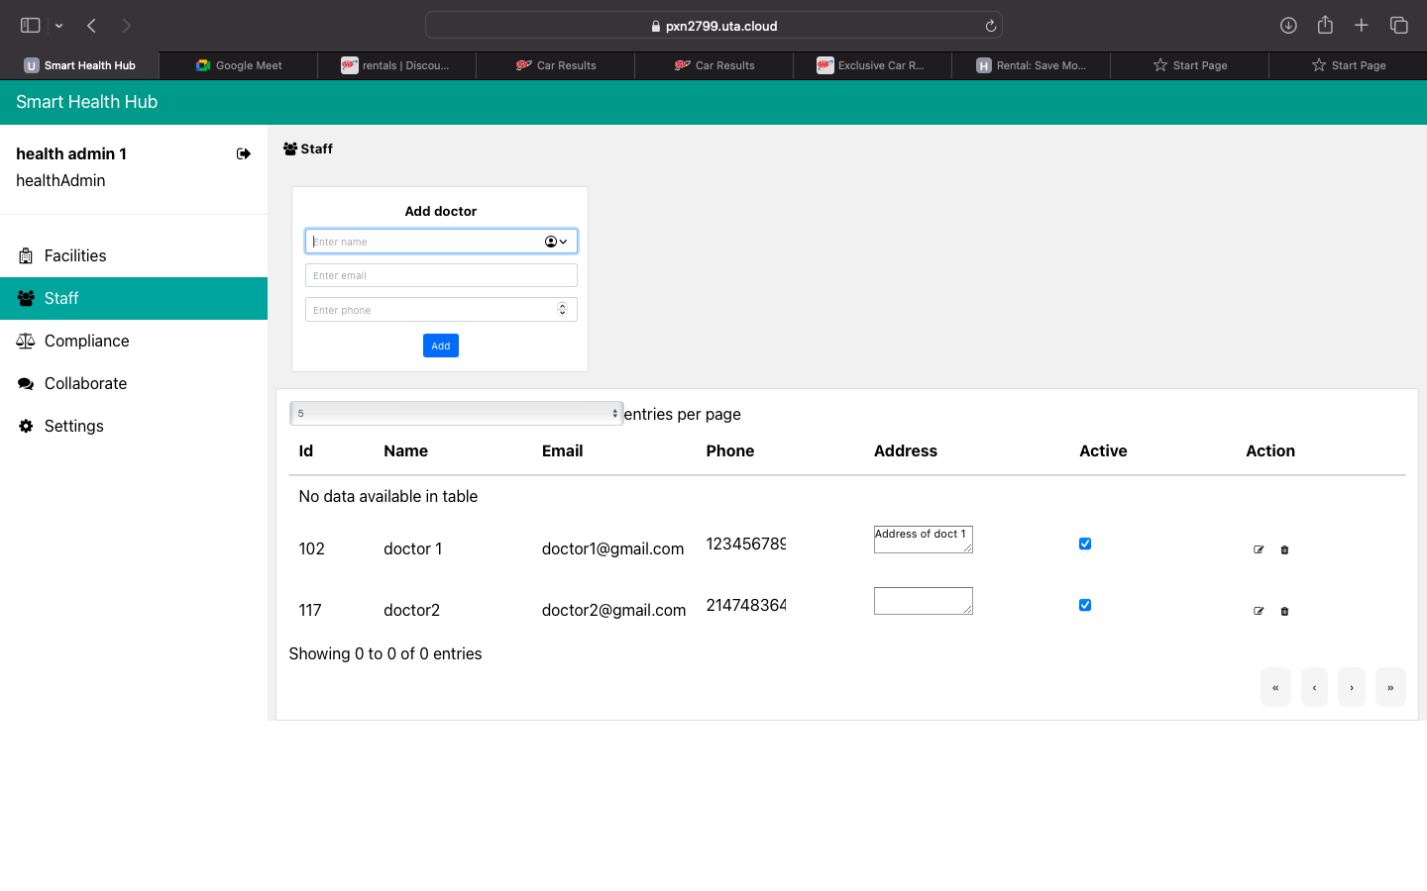
The health admin can manage the profiles of the doctors here.
The health admin can add/modify/delete profiles.

Slide 32
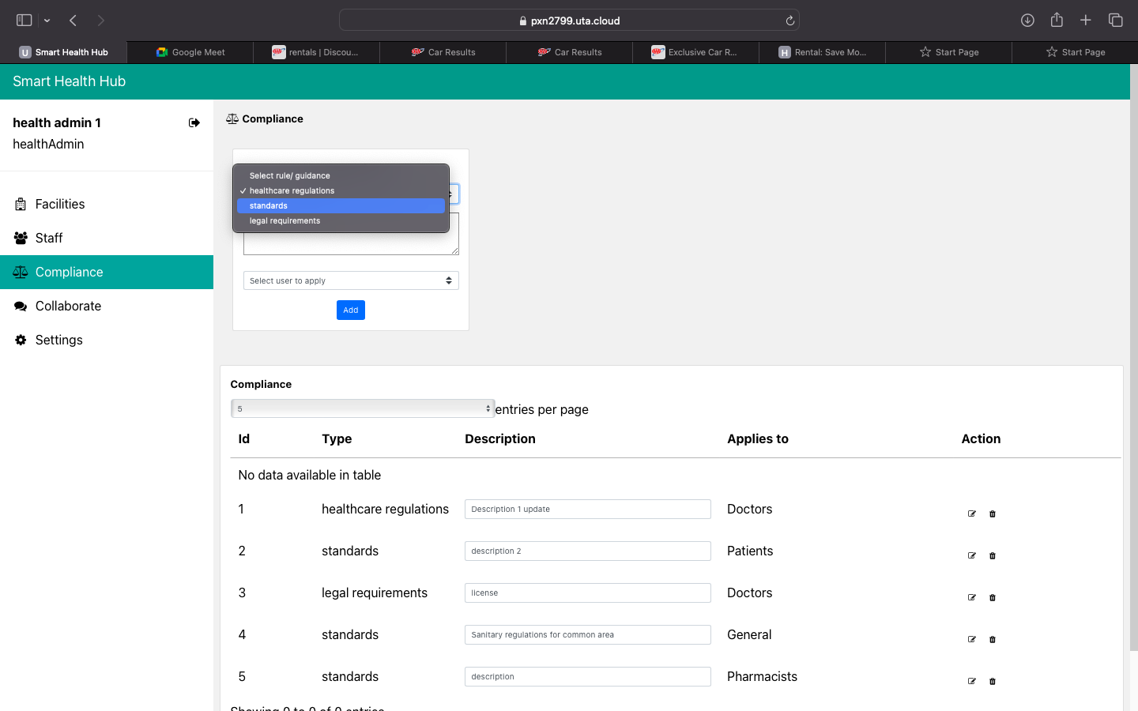
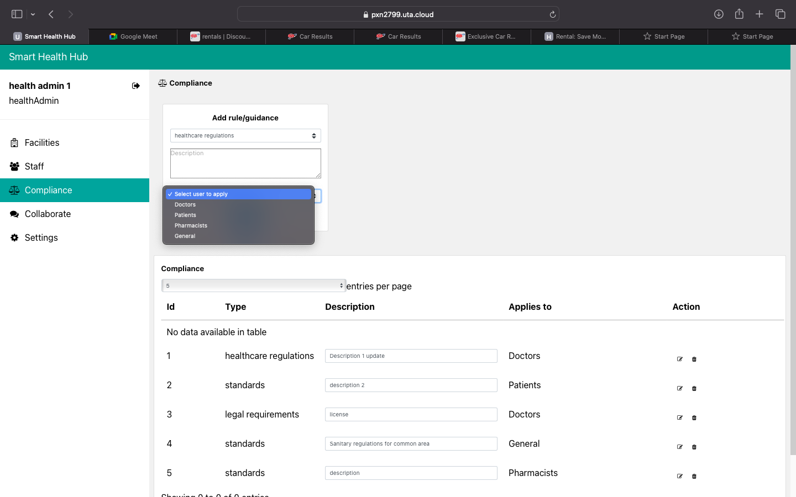
The compliance, instruction, and guidance can be added/modified/deleted here for patient, pharmacist, and doctor roles.

Slide 33
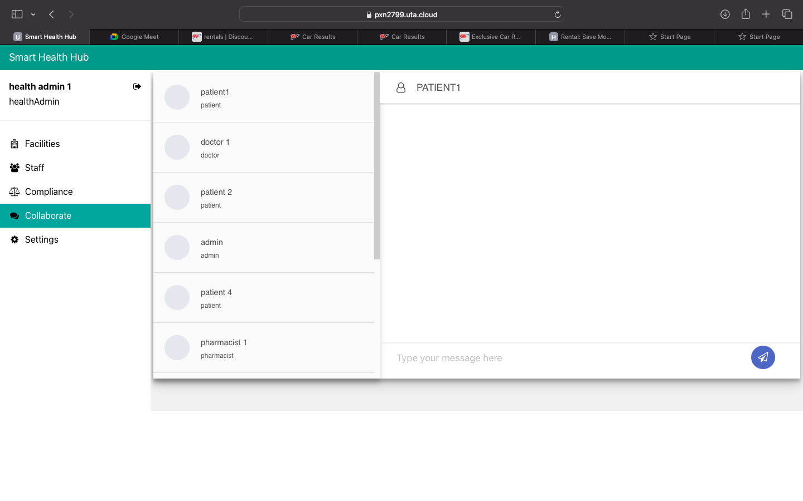
The user can chat with other users (sending/receiving messages).
Messages are exchanged privately (not visible to unrelated users).

Slide 34
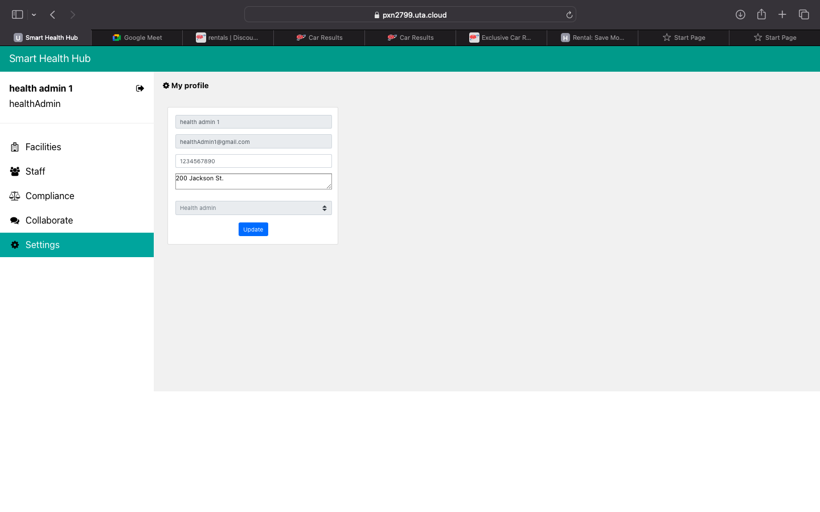
Here, users will be able to get the details of their profiles.
Also, they can update their addresses here.

Slide 35
Challenges faced
While integrating the database, backend, and frontend, the team ran into a few problems. Connectivity problems had surfaced and were fixed after a considerable amount of work by the team.
It took some time for team members to become well-versed in all the technologies, and not every member was proficient in them all.
The team encountered difficulties when creating the chat and mailer functions, which required sending emails. We were able to properly integrate them after conducting a great deal of study and going through several trials and errors.

Slide 36
Improvement
AI enables Chat Bot.
With the chart bot the users can able to interact with the application and can clarify his doute and have to access the web site.

Slide 37
Improvement
Online payment
We can provide a online payment option where users can able to pay their bill online and can have their bill stored safe and secure.

Slide 38
Improvement
Insurance
We can add the insurance policy that benefits the users about his health. With this user can able to choose an health plan based up on his interest.

Slide 39
Future Addition to your Portfolio
This project showcases our skills in both front-end and back-end development.
React being a component-based framework allows developing reusable code.
The projects comprehensive nature, encompassing all the functionality emphasizes our dedication to deliver a holistic solution.
The collaborative aspect of the project, showcasing ability to work in a group.
It not only adds tangible work to portfolio but also reflects skills in front-end, back-end, teamwork and adapting to new technologies.

